Slide 1

BANARAS HINDU UNIVERSITY
Movie Recommendation System CS-506(Major Project)
Under the supervision of
Dr. Gaurav Baranwal
Submitted by-
Name – Mohammad Salman
Class - MCA 6th semester
Roll No -17419MCA020

Slide 2
Introduction
In this project, we build a model to predict the estimated price of a car by using supervised machine learning techniques. Car price prediction is a challenging task due to the large number of attributes that should be considered for the accurate prediction. The main step in the prediction process is the collection and preprocessing of the dataset. We used an automobile dataset in this project. Before building a model, we analyze all the factors and attributes that make a significant effect on the price.

Slide 3
We build four models by using supervised machine learning techniques (Multiple Linear Regression, Polynomial Regression, Decision Tree Regression Model and Random Forest) and then select the best model for prediction based on their R-square score, mean square error and cross-validation.

Slide 4
Problem Statements:
Many automobile companies aspires to enter the market by setting up their manufacturing unit there and producing cars locally to give competition to their counter parts. They want to understand the factors affecting the pricing of cars in the market. The company wants to know:
Which variables are significant in predicting the price of a car?
What price should be estimated for the cars according their features?

Slide 5
Our Objectives:
We need to build a model for the price of cars with the available independent variables.
It will be used by the automobile companies to understand how exactly the prices vary with the Independent variables.
The company will also use it to configure the price of a car according to its features.

Slide 6
Proposed Approach:
In this section we will discuss the data science methodology, some machine learning algorithm which are used for modeling and dataset used in this project. We also discuss some essential tools and python libraries, which play a vital role in building our model.

Slide 7
Description of Datasets:
The data used in this project was downloaded from UCI Machine Learning Repository. It was uploaded donated by Jeffrey C Schlimmer in 1987. This is a multivariate dataset. It has 26 attributes and 205 instances.

Slide 8
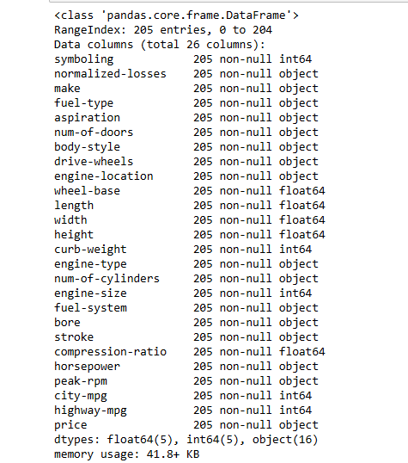

Slide 9
Data Science Methodology
Data Science Methodology indicates the routine for finding solutions to a specific problem from data. The aim of this methodology to answer the following 10 questions in this prescribed sequence:
What is the problem that you are trying to solve?
How can you use data to answer the question?
What data do you need to answer the question?
Where is the data coming from (identify all sources) and how will you get it?
Is the data that you collected representative of the problem to be solved?
What additional work is required to manipulate and work with the data?

Slide 10
In what way can the data be visualized to get the answer that is required?
Does the model used really answer the initial question or does it need to be adjusted?
Can you put the model into practice?
Can you get constructive feedback into answering the question?

Slide 11
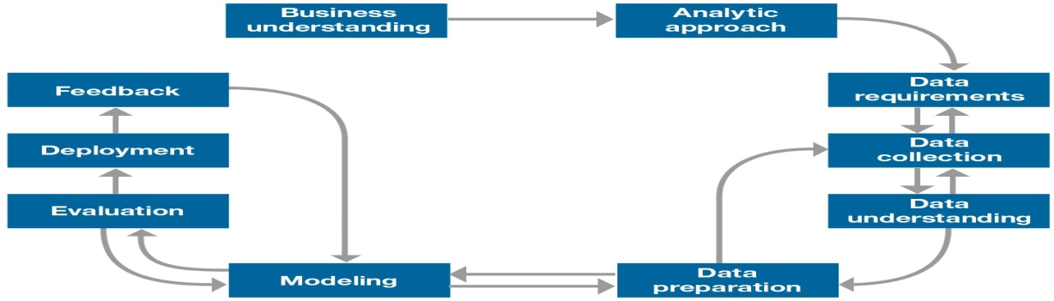
we explained all the working process in data science methodology through the following building block-

Slide 12
Machine Learning:
Learning is the method by which anyone can perform work more efficiently. Learning makes useful changes in our mind so that work can be done better than previous.
Definition: A computer program is said to learn from experience E with respect to some class of tasks T and performance measure P, if its performance at tasks in T, as measured by P, improves with experience E.

Slide 13
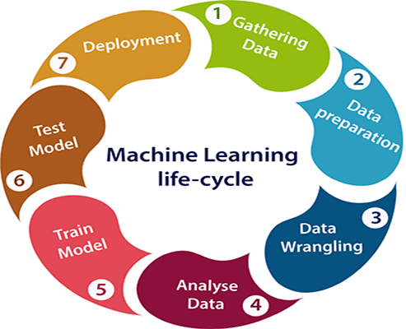
Machine Learning Life Cycle

Slide 14
Types of Machine Learning
There are mainly three types of machine learning
Supervised Machine learning
Unsupervised Machine learning
Reinforcement Learning

Slide 15
Machine Learning Algorithms Used for modelling
Regression:
Regression is a statistical process for estimating the relationships between the dependent variables or criterion variables and one or more independent variables or predictors.
Linear Regression:
linear regression is a linear approach to modeling the relationship between a scalar response (or dependent variables) and one or more explanatory variables (or independent variables). The case of one explanatory variable is called simple linear regression. For more than one explanatory variable, the process is called multiple linear regression.

Slide 16
Simple Linear Regression:
Y= mX+c
Where m is a slope and c is a intercept.
Multiple Linear Regression:
Y=a+m1*x1+m2*x2+m3*x3+…

Slide 17
Polynomial regression:
Polynomial regression is used for curvilinear data. Polynomial regression is fit with the method of least squares. The variable x has degree more than one. This is also two types, one is simple polynomial which have only one independent variable and other is multiple polynomial regression that have more than one independent variable. The equation for polynomial regression for one independent is:
y = w₁x₁ + w₂x₂ ² + 3

Slide 18
Decision tree:
Decision tree builds regression or classification models in the form of a tree structure. It breaks down a dataset into smaller and smaller subsets while at the same time an associated decision tree is incrementally developed. . The final result is a tree with decision nodes and leaf nodes. A decision node has two or more branches, each representing values for the attribute tested. Leaf node represents a decision on the numerical target. The topmost decision node in a tree which corresponds to the best predictor called root node. Decision trees can handle both categorical and numerical data.

Slide 19
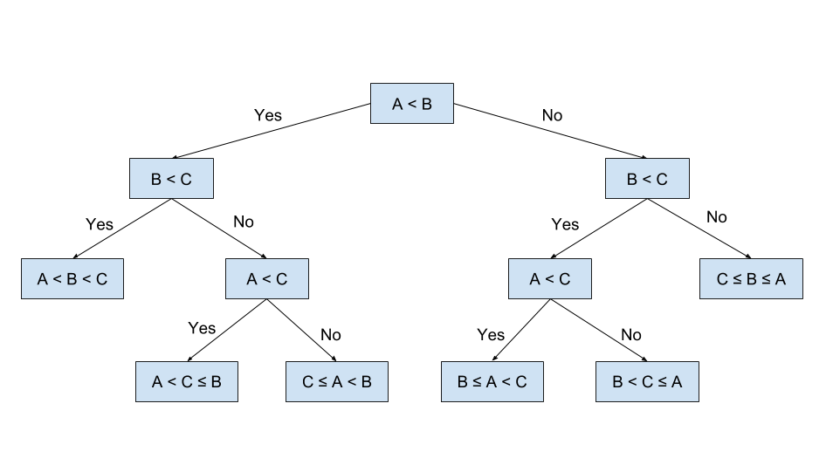

Slide 20
Random Forest:
Random Forest technique is capable of performing both regression and classification task more efficiently than any other model. Random Forest uses an ensemble of decision trees to perform regression tasks. In ensemble learning different algorithm together improve the prediction of a model. This uses different model implementation and then chooses the maximum information gain technique. In this technique maximum depth should also be define that is pruning should be made to avoid the overfitting.

Slide 21
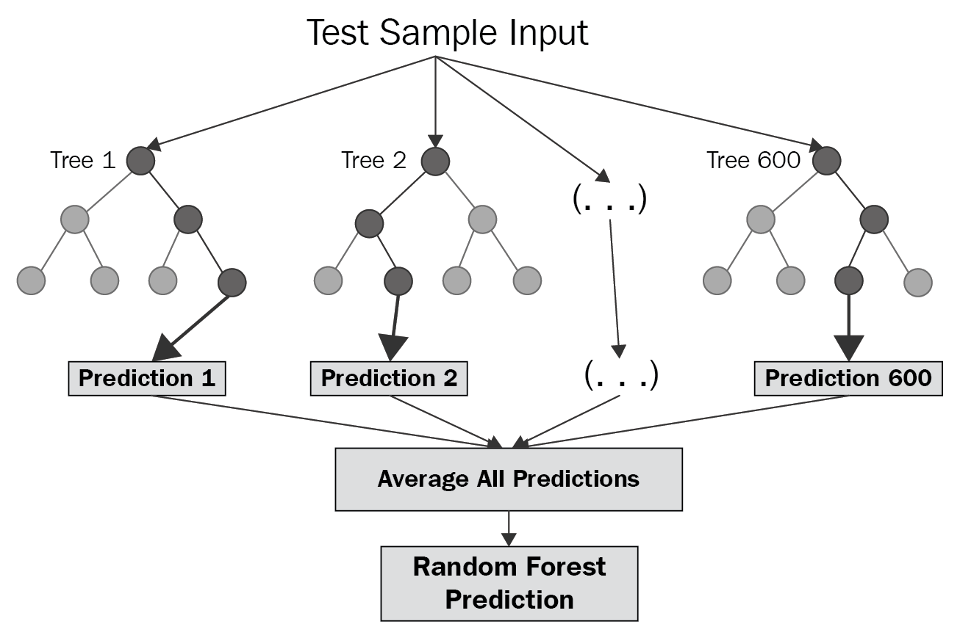

Slide 22
Implementation:
Now, we will implement our automobile price prediction model on Jupyter Notebook. There are seven main step in the working of the project.
Data Acquisition
Data Cleansing
Data Visualization and Analysis
Data Preprocessing
Model development
Model Evaluation
Save Model

Slide 23
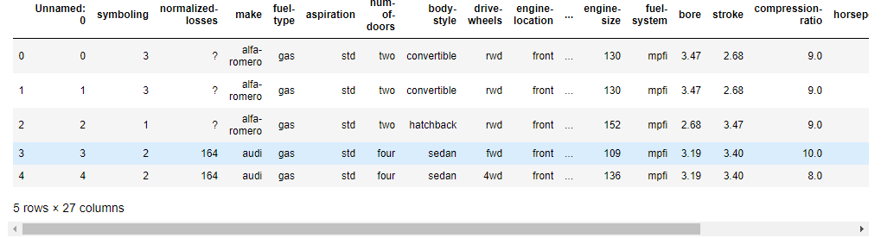
1. Data Acquisition
In this section, we load the main dataset (automobile dataset) into our Jupyter Notebook by using pandas library of the python. Here the pandas library is used for reading the CSV file by read_csv function.
Top five rows of the dataset:

Slide 24
By using the info function, we get information of the class type, the number of value in the dataset and data type of each attributes.

Slide 25
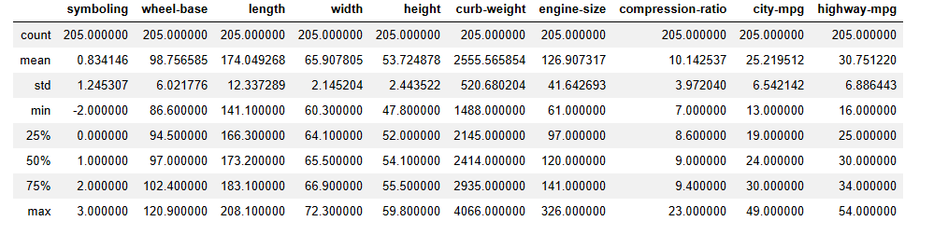
By using describe function, we represent mean, standard deviation, minimum value, the maximum value count number of data and quartile value for each numerical variable and represent number of unique values and frequency of most frequent value for categorical variables.
Describe numerical variables:

Slide 26
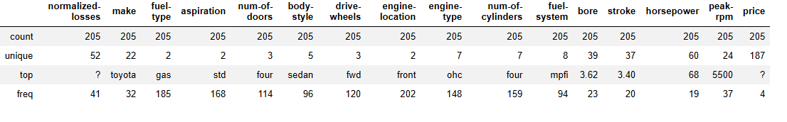
Describe categorical variables:

Slide 27
2. Data Cleansing
In this section, we will do the process of detecting and correcting corrupt or inaccurate records from the dataset and transform this raw data into a useful one because there are many problems with the datasets and it has a lot of missing values

Slide 28
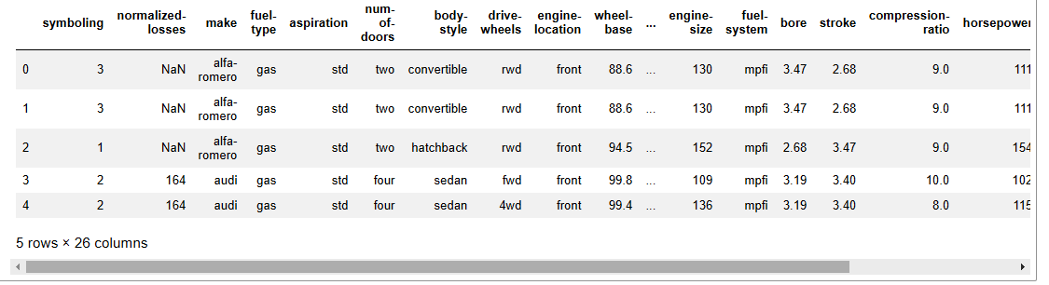
Identify missing data:
In the car dataset, missing data comes with the question mark "?". We replace "?" with NaN (Not a Number)

Slide 29
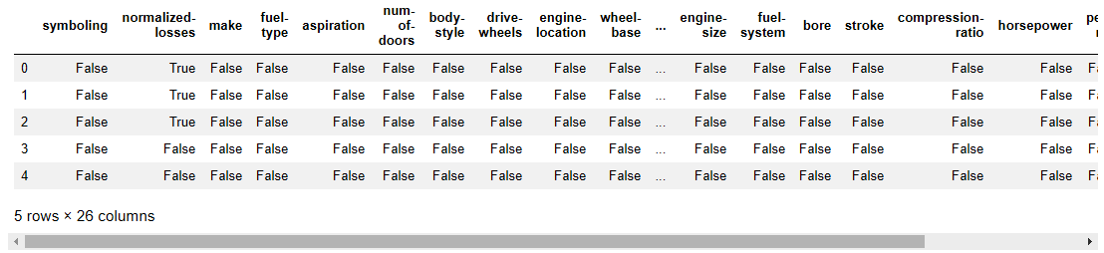
After that, we convert all the data in the form of Boolean values, in which, "True" stands for missing value, while "False" stands for not missing value.

Slide 30
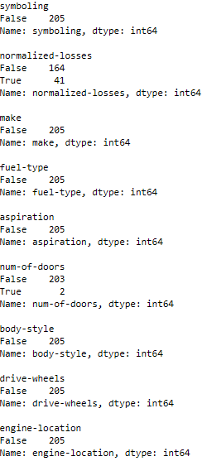
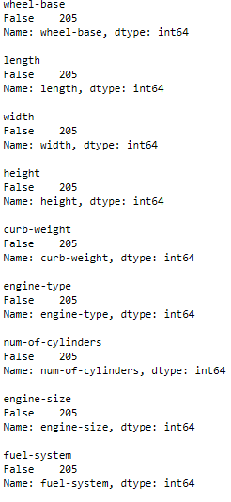
Find the attributes which have missing values:

Slide 31
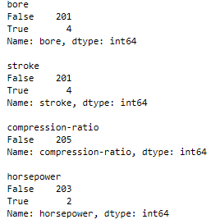
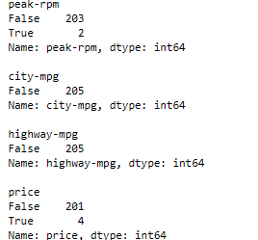

Slide 32
Based on the summary above, all column has 205 rows of data, out of those there is 19 columns have 205 false value and 0 true value, but there are seven such columns which have less than 205 false values and some true values. Those columns which have some true value show missing value columns. Those columns and there missing values are-
‘normalized-losses’: 41 missing data
num-of-doors’: 2 missing data
‘bore’: 4 missing data
‘stroke’ : 4 missing data
‘horsepower’: 2 missing data
‘peak-rpm’: 2 missing data
‘price’: 4 missing data

Slide 33
Deal with missing data:
After identify missing values, now we start dealing with missing value. We do this by one of the two following method-
Replace data:
It can be done by one of the three following method according to situation:
Replace it by mean (for numeric data)
Replace it by frequency (for categorical data)
Replace it based on other functions (for both)
Drop data:
It can be done by one of the three following method according to situation:
drop the whole row
drop the whole column

Slide 34
The missing value of the numeric attributes (‘normalized-loss’, ‘bore’, ‘stroke’, ‘horsepower’, and ‘peak-rpm’) replace by their mean, and the missing value of categorical attribute (‘num-of door’) replace by ‘four’ because 84% sedans is four doors. ‘price’ has 4 missing data, simply we delete the hole row because price is what we want to predict.

Slide 35
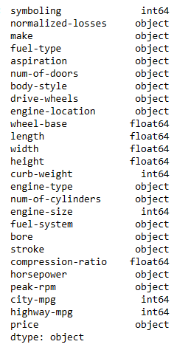
Correct the data format:
Incorrect data format:

Slide 36
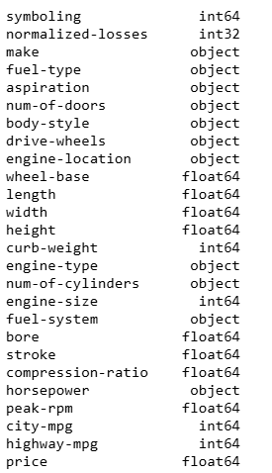
Correct data format:

Slide 37
3. Data Visualization and Analysis
In this section, we analyze the data by applying a variety of mathematical and statistical tools and techniques to explore the data and find a pattern in it and extract useful information from data.
In our dataset, there are two types of variables present, first one is numerical variable and other is categorical variables. We will apply different tools and techniques for these two type of variables for analysis the data.

Slide 38
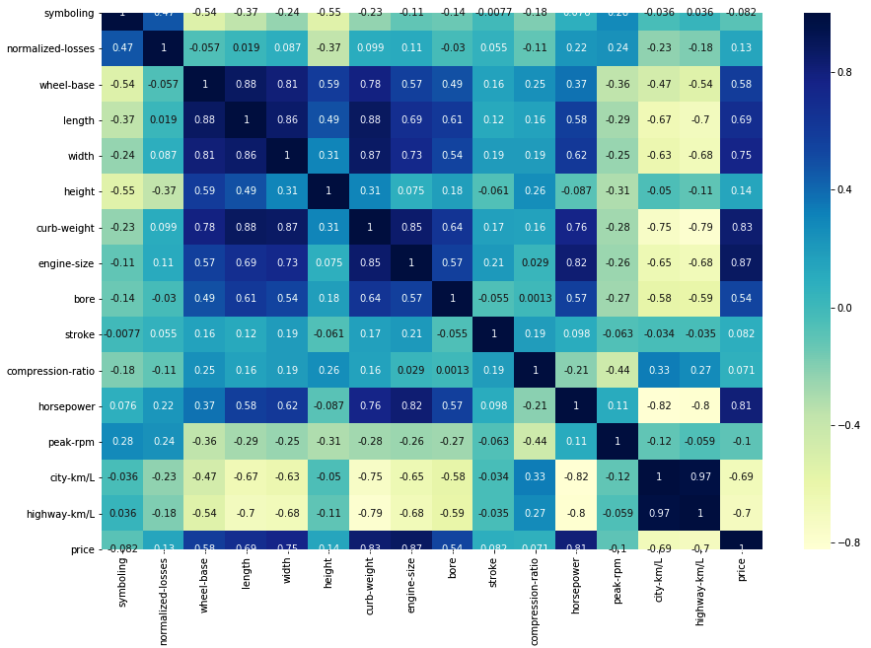
Analysis of continuous numerical variables:
Correlation:

Slide 39
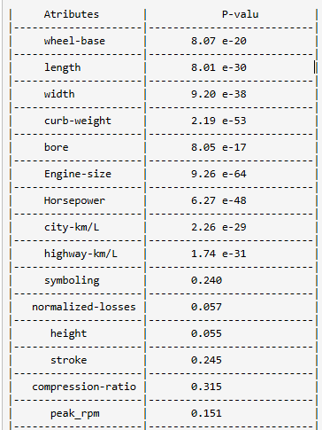
P-value:

Slide 40
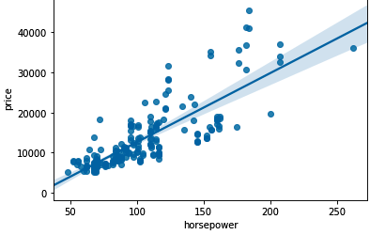
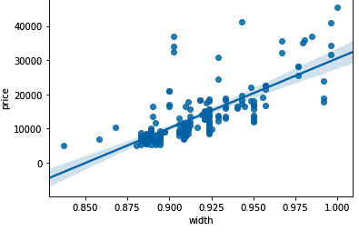
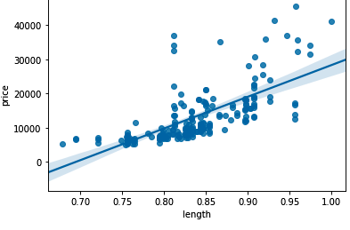
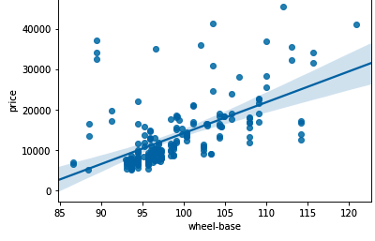
Linear Relationship:
Positive Linear Relationship:

Slide 41
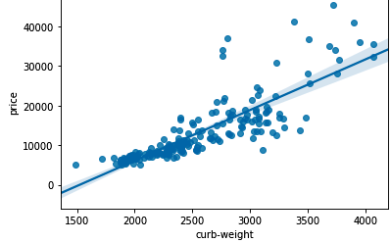
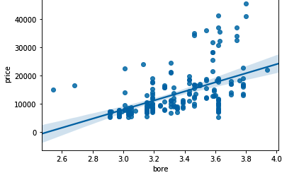
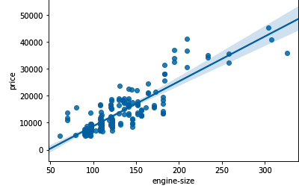

Slide 42
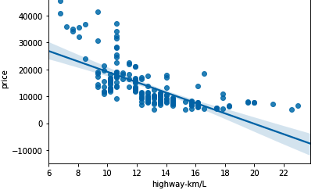
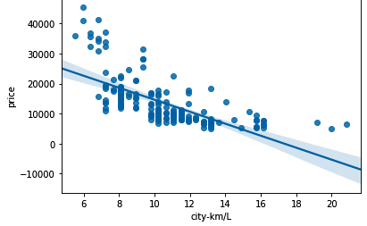
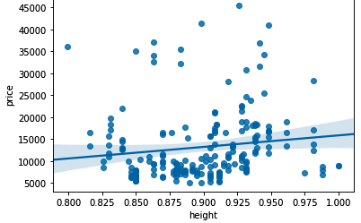
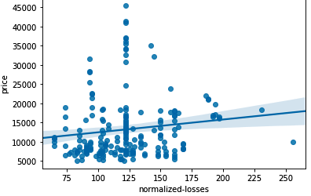
Negative Linear Relationship:
Weak Linear Relationship:

Slide 43
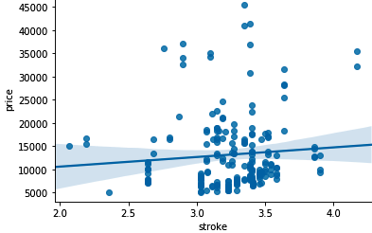
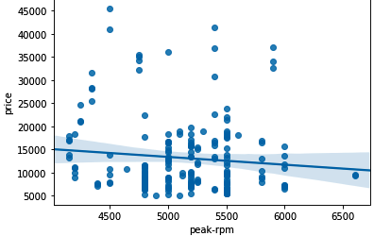
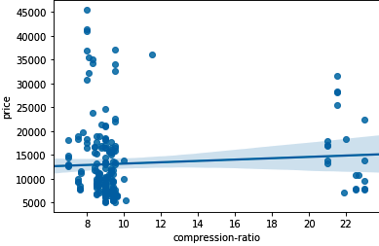
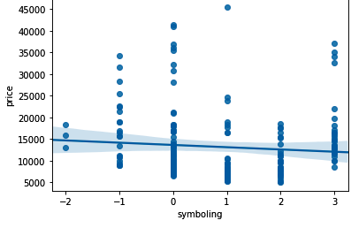

Slide 44
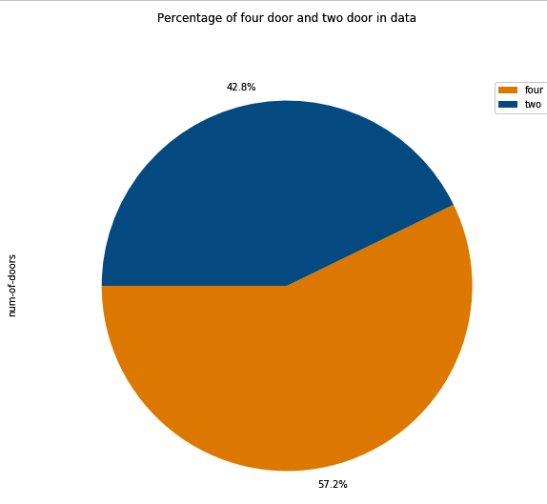
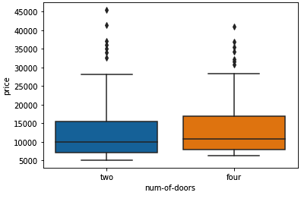
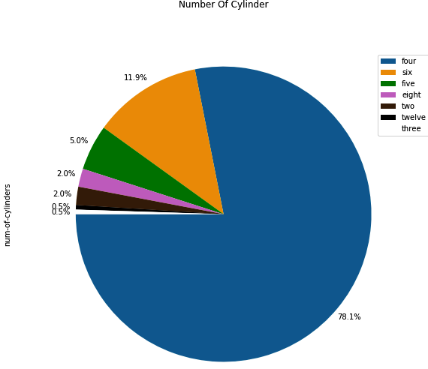
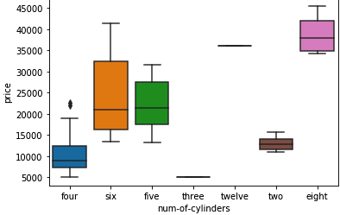
Analysis of Categorical Variables:

Slide 45
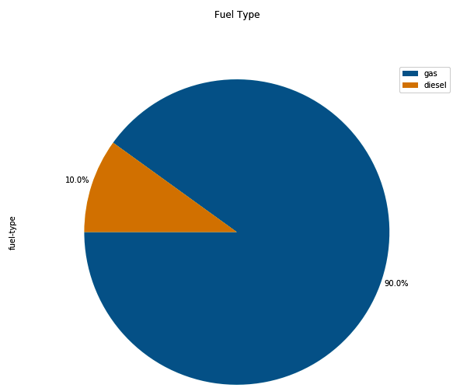
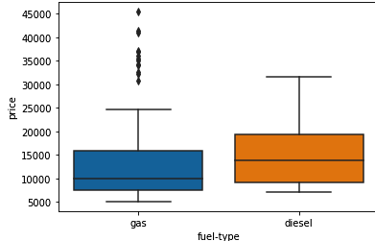
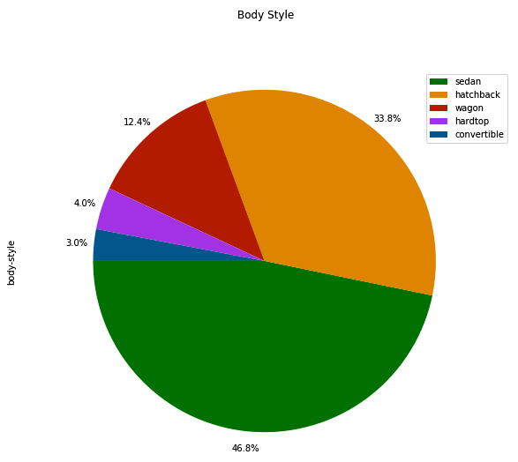
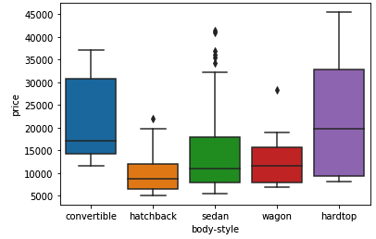

Slide 46
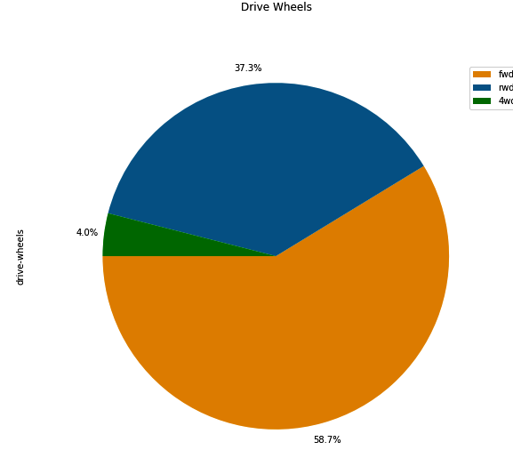
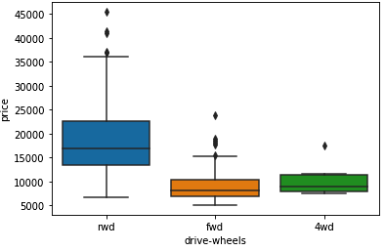
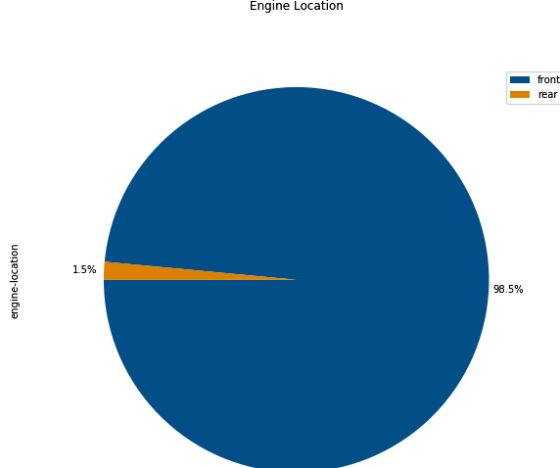
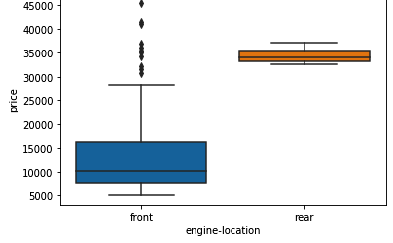

Slide 47
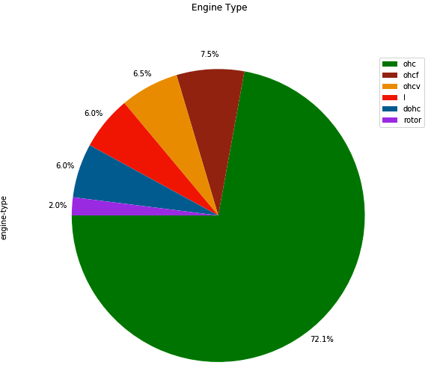
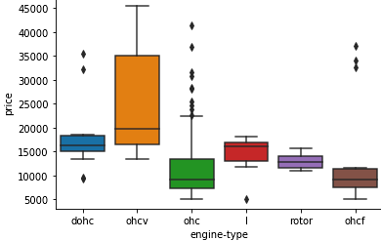
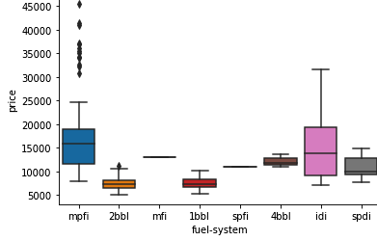
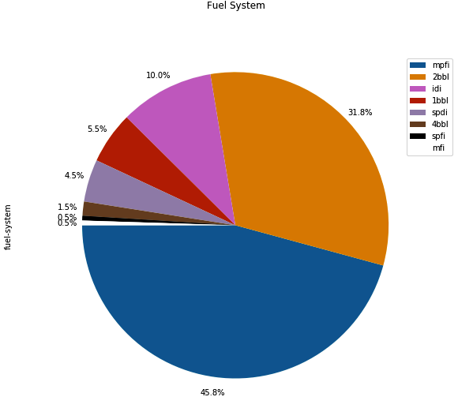

Slide 48
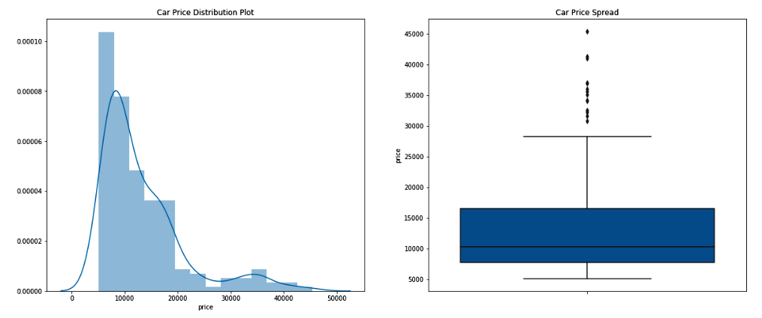

An examination of price trend:

Slide 49
Conclusion: Important variables-
We now have a better idea of what our data looks like and which variables are important to take into account when predicting the car price. We have narrowed it down to the following variables:
Continuous numerical variables:
Length
Width
Curb-weight
Engine-size
Horsepower
City-km/L
Highway-km/L
Wheel-base
Bore
Categorical variables:
Drive-wheels

Slide 50

4. Data Pre-processing:
One Hot Encoding:

Slide 51
Data Standardization:
In our dataset, the fuel consumption columns "city-mpg" and "highway-mpg" are represented by mpg (miles per gallon) unit. We are developing this model for our country that accept the fuel consumption with km/L standard. So we have to transform ‘mpg’ into ‘km/L’ standard by using formula-
Km/L= mpg /2.35
Data Normalization
We are going to normalize the columns "length", "width" and "height" so their value ranges from 0 to 1.
Replace original value by (original value)/(maximum value).

Slide 52

5. Model development
Data splitting:
Before going through the modeling process, we randomly split our data into training and testing data using the function train_test_split. In this process, 75% of the data was split for the train data and 25% of the data was taken as test data.

Slide 53


Model -1: Multiple Linear Regression:
Distribution plot and Scatter plot between actual value and predicted value of train data for Multiple Linear Regression

Slide 54


Distribution plot and Scatter plot between actual value and predicted value for test data for Multiple Linear Regression

Slide 55


Model -2: Polynomial Regression:
Distribution plot and Scatter plot between actual value and predicted value for train data for Polynomial Regression

Slide 56


Distribution plot and Scatter plot between actual value and predicted value for test data for Polynomial Regression

Slide 57


Model -3: Decision Tree Regression:
Distribution plot and Scatter plot between actual value and predicted value for train data for Decision Tree Regression

Slide 58


Distribution plot and Scatter plot between actual value and predicted value for test data

Slide 59


Model -4: Random Forest Regression:
Distribution plot and Scatter plot between actual value and predicted value for train data and Random Forest Regression

Slide 60


Distribution plot and Scatter plot between actual value and predicted value for test data for Random Forest Regression

Slide 61
Now we are too confused to select the best model, which gives the best prediction because we cannot all plot looks very. Now we want a quantitative measure to determine how accurate the model is. In the next section (model evaluation), we do all things for the selection of the best model.

Slide 62
6. Model evaluation
In this section we will evaluate all the models by using quantitative measure. Now we are going to use two very important measures that are often used in Statistics to determine the accuracy of a model are:
R^2 / R-squared
Root Mean Squared Error (RMSE)

Slide 63
General Evaluation:
We have four different models, and we are going to generate R-squared and RMSE values for each model in general way. For determine a good model fit, we will focus on two points-
The model with the higher R-squared value is a better fit for the data.
The model with the smallest RMSE value is a better fit for the data.

Slide 64


Slide 65
Model Evaluation by using K-fold Cross-Validation:
Here, we split the data into four equal folds; it may be called 4-fold cross-validation. We use three parts out of four to train the model and use one remaining part for test the model. So, we use each and every fold to test the model and the remaining three parts for training the model.
Therefore we have four R-squared values and four RMSE values for each model. We calculate the mean of both R-squared values and RMSE values for a model. After that, we compare all the scores of the four models and select the best model.

Slide 66


Slide 67

R^2 Score:

Slide 68

RMSE Values:
Inference: As we saw both tables show above, we can understand that random forest model has the lowest mean of RMSE value and the highest mean of R-squared score for both training and testing dataset among all four models.

Slide 69
7. Save Model
After all the process given above, we save the model which has the lowest RMSE value and the highest mean of R-squared score. We use this saved model for future uses for the prediction of unknown data by using joblib library function of python.

Slide 70
Result And Discussion
After implementing all the process, we can see that the following feature of the cars act a significant role in estimating the price of the car.
Length
Width
Curb-weight
Engine-size
Horsepower
City-km/L
Highway-km/L
Wheel-base
Bore
Drive-wheels

Slide 71
We evaluate all the four models by finding their R-squared score and RMSE values by applying test dataset. We also use K-fold cross-validation for the evaluation process. After that, we discovered that our random forest regression model fitted very well and has the lowest RMSE value (3198.41) and the highest mean of R-squared score (0.7574) among all the models.

Slide 72


Test The Model With New Dataset

Slide 73


Scatter plot for the difference between the predicted value and the actual value of a particular car n the model testing:
R^2 score and RMSE value for test dataset

Slide 74
Discussion On Result
After applying the test data and analyzing the above figure, we can conclude the following results-
As we can see in the distribution plot, the fitted values are very close enough to the actual values
In the scatter plot shown above, we observed that the most of the values (or dots) are either lying on the straight line or too close to it, too few of them are at a very short distance from the line.
After analyzing the scatter plot between the price and error of prediction, we observed that most of the values (or dots) is very close enough to the zero on the y-axis. Maximum dots show the error between -2000 to 2000 in price. Too few of them have error out of the range -2000 to 2000.

Slide 75
D. This model has an R-squared score is 0.8969, and RMSE value is 2573.0688. It is perfect for a good model.
After observing the above results, we can say that our model works efficiently and predict the price nearly equal to the actual price of most of the cars.

Slide 76
Conclusion:
In this project, I tried to analysis of all features of the car and try to find important feature that act a significant role in the prediction of the price of the car and build a model by using data science process. This model can predict the price of cars based on its features or attributes. In the process of building the model, at the first stage, we collect the data, cleaned the data and preprocessed. With the help of the exploratory data analysis and the data visualizations, we explored the data deeply and uncovered the hidden pattern in the data. We find a meaningful relationship between features.
This model works efficiently for a given data. This model can be used for business purpose. It will give benefit to both buyer and seller, and save money and time of the user.

Slide 77
Limitations of the study and suggestions for the future works
The main limitation of this project is the low number of data that have been used. We use only 205 data. Gathering more data can yield more robust predictions. As a suggestion for future work, we intend to use more advanced techniques like artificial neural networks, fuzzy logic and genetic algorithms to predict car prices. We can add some other advance features and techniques like CNN and computer vision to predict the price of automobiles other than cars and so on.

Slide 78
References:
Gareth, J., Daniela, W., Trevor, H., & Tibshirani, R. (2013). An Introduction to Statistical
Gongqi, S., Yansong, W., & Qiang, Z. (2011, January). New Model for Residual Value Prediction of the Used Car Based on BP Neural Network and Nonlinear Curve Fit. In Measuring Technology and Mechatronics Automation (ICMTMA), 2011 Third International Conference on (Vol. 2, pp. 682-685). IEEE.
Pudaruth, S. (2014). Predicting the price of used cars using machine learning techniques. Int. J. Inf. Comput. Technol, 4(7), 753-764.
Noor, K., & Jan, S. (2017). Vehicle Price Prediction System using Machine Learning Techniques.International Journal of Computer Applications, 167(9), 27-31.
Weka 3 - Data Mining with Open Source Machine Learning Software in Java. (n.d.), Retrieved from:https://www.cs.waikato.ac.nz/ml/weka/. [August 04, 2018].
Ho, T. K. (1995, August). Random decision forests. In Document analysis and recognition, 1995.proceedings of the third international conference on (Vol. 1, pp. 278-282). IEEE.

Slide 79
https://gallery.azure.ai/Experiment/Automobile-price-prediction-256
https://towardsdatascience.com/build-develop-and-deploy-a-machine-learning-model-to-predict-cars-price-using-gradient-boosting-2d4d78fddf09
https://en.wikipedia.org/wiki/Data_analysis
https://machinelearningmastery.com/k-fold-cross-validation/#:~:text=Cross%2Dvalidation%20is%20a%20resampling,k%2Dfold%20cross%2Dvalidation.
https://www.saedsayad.com/decision_tree_reg.htm
https://www.geeksforgeeks.org/random-forest-regression-in-python/
https://www.geeksforgeeks.org/random-forest-regression-in-python/

Slide 80
Thank You

